Slide 1

Current Therapeutic Options in Glioblastoma:
Progress or Status Quo?
James R Perry, MD, FRCPC
Crolla Chair of Brain Tumour Research
Sunnybrook Health Sciences Centre
University of Toronto
Toronto, Ontario, Canada

Slide 2
Current Standard of Care for Newly Diagnosed Glioblastoma
Maximal safe resection
  No ‘level 1’ evidence
  But strong supporting evidence from recent randomized controlled trials as a significant prognostic factor for OS
  Allows sufficient tissue for molecular diagnostics, screening for clinical trials
  Aided by advances in imaging, surgical neuronavigation, 5- ALA

Slide 3
Approach to Newly
Diagnosed Glioblastoma
Maximal safe resection
60 Gy RT + concomitant/adjuvant temozolomide for appropriate patients
Unmethylated MGMT
Methylated MGMT
Randomization: RT TMZ/RT
Median OS, mo: 11.8 12.7
2-yr survival: 1.9% 13.8%
Randomization: RT TMZ/RT
Median OS, mo: 15.3 21.7
2-yr survival: 22.7% 46.0%
100
100
90
90
80
Logrank P = .062
80
Logrank P = .0074
70
70
60
60
TMZ/ RT
Overall Survival
Overall Survival
50
TMZ/RT
50
40
40
30
RT alone
30
RT alone
20
20
10
10
0
0
0
4
8
12
16
20
24
28
32
36
40
0
5
10
15
20
25
30
35
40
Months
Months
Hegi ME, et al. N Engl J Med. 2005;352(10):997-1003.

Slide 4
Radiation and Concurrent Temozolomide
Patient selection issues for newly diagnosed patients
  Unmethylated patients
  Poor PS
  Multifocal large burden of disease
  Elderly patients
Therapeutic issues
  duration of adjuvant chemotherapy
  dose/schedule of temozolomide
  pseudoprogression

Slide 5






NOA-08/Methvsalem
Temozolomide (one week on/one week off) vs radiotherapy in the primary treatment of anaplastic astrocytoma and glioblastoma in elderly patients: a randomized phase III-study
Temozolomide
PD
Radiotherapy
Histology
3
9
12
27
30
33
weeks
PD
Temozolomide
Radiotherapy
TMZ 100 mg/m² po/day for 7 days every 14 days
until failure of therapy, to be adjusted in 25-mg steps
Focal radiotherapy daily — 30 x 1.8-2 Gy to a total 54–60 Gy
Gütesiegel A
Wick W, et al. J Clin Oncol. 2010;28(18s): Abstract LBA2001; Wick W, et al. Lancet Oncol. 2012;13(7):707-715.

Slide 6


NOA-08/Methvsalem: Overall Survival According to MGMT-Status and Treatment
N0A-08
100
90
80
70
60
50
40
30
20
10
0
MGMT+ and RT
MGMT- and RT
MGMT+ and TMZ
MGMT- and TMZ
P = .009
0 30 60 90 120 150 180 210 240 270 300 330 360 390
Number at Risk
RT
MGMT + 42 41 39 34 33 29 27 24 24 20 18 16 16 15
MGMT – 59 59 56 52 47 45 45 39 35 33 29 24 19 18
TMZ
MGMT+ 31 31 29 29 29 28 25 25 22 20 20 18 16 15
MGMT- 77 76 73 66 55 50 42 37 31 28 24 23 18 17
Wick W, et al. Lancet Oncol. 2012;13(7):707-715.

Slide 7
Issues With Adjuvant Chemotherapy
Standard of care = 6 months
No benefit in either mMGMT or unMGMT with dose-dense TMZ (21/28 days, RTOG 0525)
Many practitioners extend to 12 months or even until progression, but no evidence to support this
Pseudoprogression can occur within the first 2 cycles of adjuvant TMZ, and even for up to 6 months or more

Slide 8
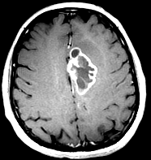
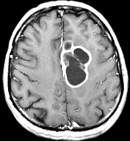
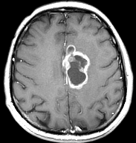
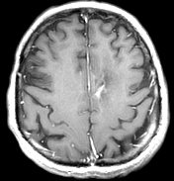
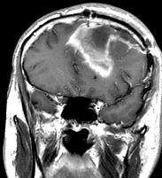
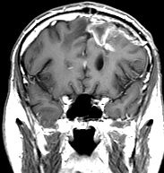
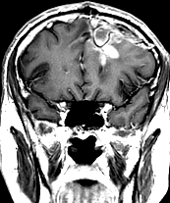
Pseudoprogression
27 cc 47 cc 34 cc 0.4 cc
A
B
Post-op pre-RT 1 month post-RT 5 months post-RT 11 months post-RT

Slide 9
“Pseudoprogression”
Detection of increased enhancement/edema following completion of chemoradiation
  Seen in the past, even with conventional RT alone, but especially with brachytherapy and intracavitary treatment
MRI at 4 wks post-RT/TMZ:
  up to 30%-50% of patients have PD by conventional criteria
  half of these are asymptomatic
  Of these, up to half have resolution of these changes over several months
This may be more common in MGMT-positive pts [Brandes AA, et al. J Clin Oncol. 2008;26(13):2192-2197.]
But no difference in rate of pseudoprogression in the AVAglio trial (unmethylated vs methylated) [Wick W, et al. J Clin Oncol. 2013;31(Suppl): Abstract 2002.]
Thus far advanced MRI techniques, perfusion imaging, metabolic imaging not reliable enough for routine use….unmet need.

Slide 10
Options for Recurrent Glioblastoma
Re-resection
  -to confirm presence of active disease
Re-irradiation increasingly considered
Systemic chemotherapy
  TMZ rechallenge
  Lomustine
  Others not commonly used such as PCV, etoposide
  No good controlled trials in the TMZ era
VEGF-targeted therapy: bevacizumab +/- chemotherapy
No biomarkers to assist with patient selection

Slide 11
Systemic Therapy Options for
Recurrent Glioblastoma: The Evidence
2nd-line systemic therapies:
  No clear standard of care
  Goals of care: preservation of function, extend survival, minimize toxicities
    Stable disease (SD) is a desirable outcome
    6-mo PFS is the current gold standard used in neuro-oncology to judge efficacy of new agents. Standard for regulatory approval
  TMZ was previously used for patients who recurred after RT-alone (pre-Stupp 2005)
    5% response rate on imaging, 15% 6-mo PFS
Very few studies post-2005
  Lomustine (CCNU): 19% 6-mo PFS, median OS 6.1 mo
  Daily temozolomide: 24% 6-mo PFS, median OS 10 mo
  Bevacizumab: 30%-50% 6-mo PFS, median OS 9 mo

Slide 12
Surgery, RT/TMZ: We’re Now a Decade Later….Have We Improved?
No benefit to date seen in RT/TMZ + “x” studies
No noteworthy agents in unmethylated newly diagnosed GBM using RT + “x”: huge unmet need. 60% of patients
The recent mass funeral of upfront approaches:
  RTOG 0525
  RTOG 0825 (bevacizumab)
  Avaglio (bevacizumab)
  CENTRIC (cilengitide, integrin inhibitor, mMGMT)
  CORE (cilengitide, uMGMT)

Slide 13
Why These Failures and Others
We don’t often know if the drug reaches its theoretical target and, even if it does, does it cause the anticipated downstream effect?
Beyond MGMT, no biomarkers are helpful in GBM
Not enough enriched trials
Not enough trials with surgery after drug exposure
Not enough trials of rationale combinations

Slide 14
The Emergence of Bevacizumab in Neuro-oncology
Strong biological rationale
  humanized anti-VEGF monoclonal Ab
  strong VEGF upregulation and expression
  VEGF drives robust angiogenesis
Development in GBM delayed: fears of thrombosis and bleeding (especially ICH)
2 uncontrolled trials:
  Unprecedented response rates and 6-mo PFS
But 2 very discouraging RCTs in newly diagnosed patients. Some PFS benefit, but conflicting data on QoL, neurocognition

Slide 15
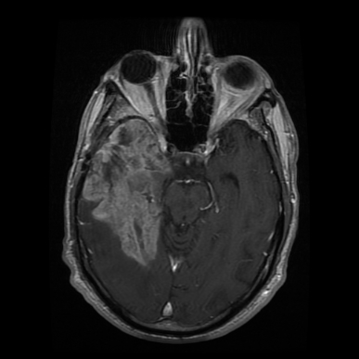
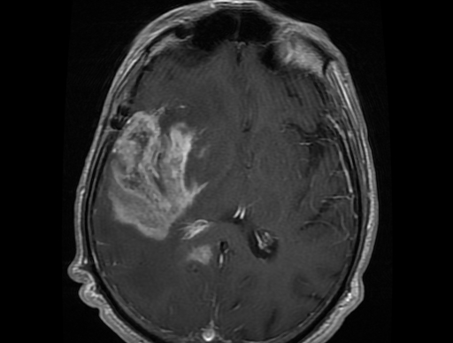
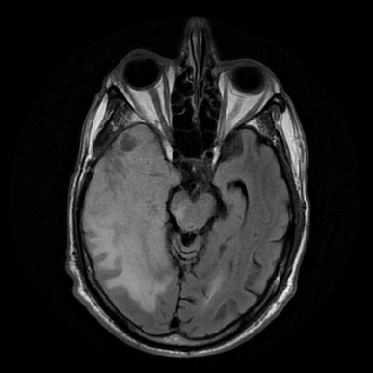
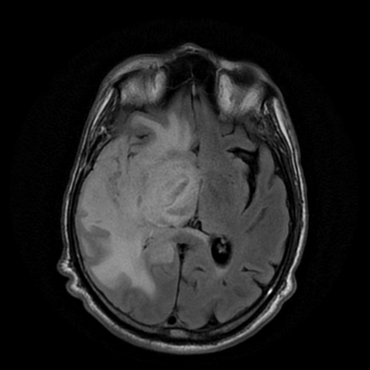
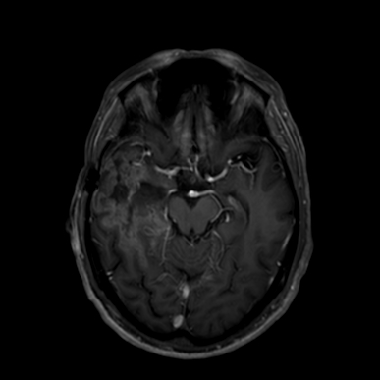
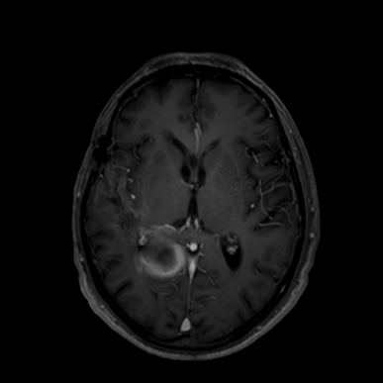
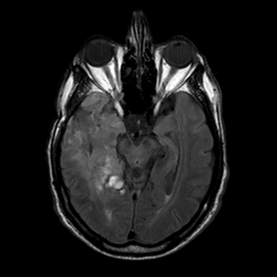
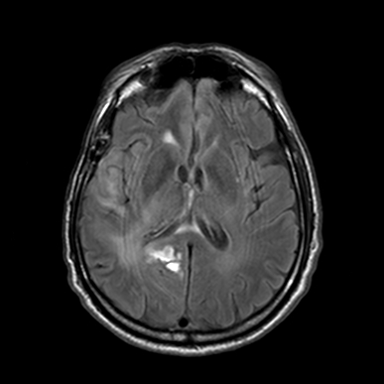
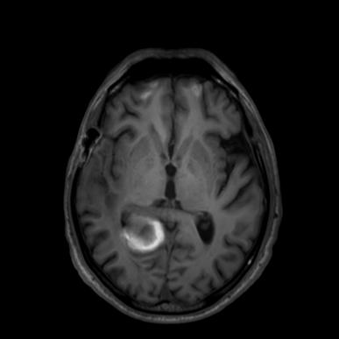
Response to 2 Doses of Bevacizumab, MRI Scans 4 Weeks Apart

Slide 16
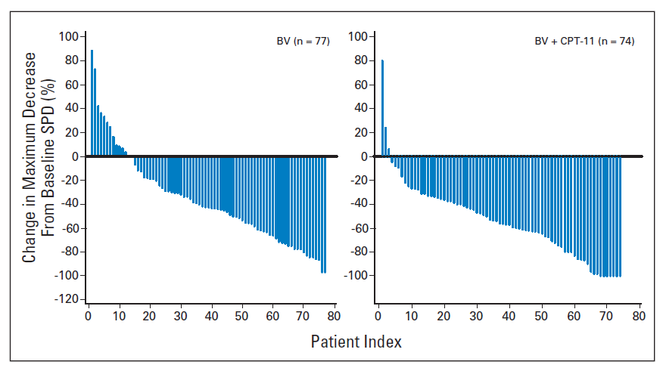
Bevacizumab – Response Rate and Reductions in Dexamethasone Use
Change in Corticosteroid Dose Across Time
10 –
8 –
6 –
4 –
2 –
0 –
Percentile by Dose
75%
50%
25%
Corticosteroid Dose, mg
Baseline 84 168 252 336
Time, Days
No. of pts 86 86 73 49 40 31 24 15 8 2
42-day averages of corticosteroid dose were calculated for each patient for whom data were available from baseline until disease progression or final study dose, whichever occurred first. The median (ie, 50th-percentile), 25th-percentile, and 75th-percentile doses are shown for each timepoint. The number of patients included in the analysis at each timepoint is noted below the x-axis.
Friedman HS, et al. J Clin Oncol. 2009;27(28):4733-4740.

Slide 17
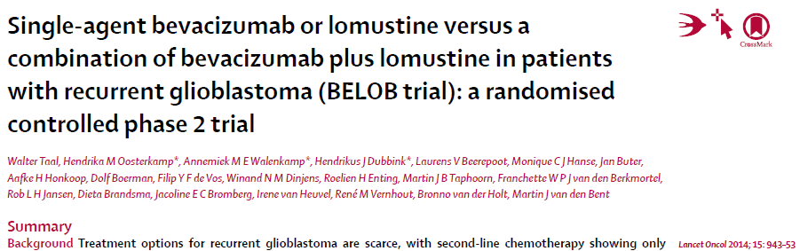
100 –
75 –
50 –
25 –
0 –
 | Bevacizumab n = 50 | Lomustine n = 46 | BEV/LOM 110 n = 8 | BEV/LOM 90 n = 44 | BEV/LOM All n = 52
Objective response rate | 18/48 (38%, 24-53) | 2/41 (5%, 1-17) | 5/8 (63%, 24-91) | 14/41 (34%, 20-51) | 19/49 (39%, 25-54)
Median PFS, months | 3 (3-4) | 1 (1-3) | 11 (1-27) | 4 (3-8) | 4 (3-8)
6-month PFS | 16% (7-27) | 13% (5-24) | 50% (15-77) | 41% (26-55) | 42% (29-55)
Median OS, Months | 8 (6-9) | 8 (6-11) | 16 (2-34) | 11 (8-12) | 12 (8-13)
12-month OS | 26% (15-39) | 30% (18-44) | 63% (23-86) | 45% (30-59) | 48% (34-61)
BEV/LOM 110
Bevacizumab
Lomustine
Bev/LOM 90
Overall Survival, %
N
8
50
46
44
Deaths
7
50
46
41
Bev/LOM 110
Bevacizumab
Lomustine
BEV/LOM 90
0 6 12 18
Months
Data are n/n evaluable (%, 95% CI), or % (95% CI). BEV/LOM 110 = bevacizumab plus lomustine 110 mg/m². BEV/LOM 90 = bevacizumab plus lomustine 90 mg/m². BEV/LOM ALL = all patients who received combination treatment of bevacizumab plus lomustine. Evaluable = number of patients evaluable for objective response.
Number at risk
BEV/LOM 110 8 7 5 2
Bevacizumab 50 31 13 3
Lomustine 46 30 14 3
BEV/LOM 90 44 34 20 9
Taal W, et al. Lancet Oncol. 2014;15(9):943-953.

Slide 18
So, What Are the Major Unmet Needs for Glioblastoma Therapy in 2014?
Better therapies!
In particular for unMGMT GBM
Novel imaging to detect treatment effects versus disease progression
Biomarkers: prognostic and predictive, especially for bevacizumab at present
Better designed clinical trials: are drugs reaching their targets, combinations

